Slide 1
Java Basics
Instructor :Prashant Mishra
BIAS Bhimtal

Slide 2
What is Java
Java is a programming language and a platform.
Java is a high level, robust, object-oriented and secure programming language.
Platform: Any hardware or software environment in which a program runs, is known as a platform. Since Java has a runtime environment (JRE) and API, it is called a platform.

Slide 3
Application
There are many devices where Java is currently used. Some of them are as follows:
Desktop Applications such as acrobat reader, media player, antivirus, etc.
Web Applications such as irctc.co.in.
Enterprise Applications such as banking applications.
Mobile
Embedded System
Smart Card
Robotics
Games, etc.

Slide 4
Types of Java Applications
There are mainly 4 types of applications that can be created using Java programming:
1) Standalone Application:
Standalone applications are also known as desktop applications or window-based applications. These are traditional software that we need to install on every machine. Examples of standalone application are Media player, antivirus, etc. AWT and Swing are used in Java for creating standalone applications.
2) Web Application:
An application that runs on the server side and creates a dynamic page is
called a web application. Currently, Servlet, JSP, Struts, Spring, Hibernate, JSF,
etc. technologies are used for creating web applications in Java.
3) Enterprise Application:
An application that is distributed in nature, such as banking applications, etc. is called enterprise application. It has advantages of the high-level security, load balancing, and clustering. In Java, EJB is used for creating enterprise applications.
4) Mobile Application:
An application which is created for mobile devices is called a mobile application. Currently, Android and Java ME are used for creating mobile applications.

Slide 5
Java Platforms / Editions
There are 4 platforms or editions of Java:
1) Java SE (Java Standard Edition):
It is a Java programming platform. It includes Java programming APIs such as java.lang, java.io, java.net, java.util, java.sql, java.math etc. It includes core topics like OOPs, String, Regex, Exception, Inner classes, Multithreading, I/O Stream, Networking, AWT, Swing, Reflection, Collection, etc.
2) Java EE (Java Enterprise Edition):
It is an enterprise platform which is mainly used to develop web and enterprise applications. It is built on the top of the Java SE platform. It includes topics like Servlet, JSP, Web Services, EJB, JPA, etc.
3) Java ME (Java Micro Edition):
It is a micro platform which is mainly used to develop mobile applications.
4) JavaFX:
It is used to develop rich internet applications. It uses a light-weight user interface API.

Slide 6
History of Java
1) James Gosling, Mike Sheridan, and Patrick Naughton initiated the Java language project in June 1991. The small team of sun engineers called Green Team.
2) Originally designed for small, embedded systems in electronic appliances like set-top boxes.
3) Firstly, it was called "Greentalk" by James Gosling, and file extension was .gt.
4) After that, it was called Oak and was developed as a part of the Green project.
5) Why Oak? Oak is a symbol of strength and chosen as a national tree of many countries like U.S.A., France, Germany, Romania, etc.
6) In 1995, Oak was renamed as "Java" because it was already a trademark by Oak Technologies.

Slide 7
7) Why had they chosen java name for java language? The team gathered to choose a new name. The suggested words were "dynamic", "revolutionary", "Silk", "jolt", "DNA", etc. They wanted something that reflected the essence of the technology: revolutionary, dynamic, lively, cool, unique, and easy to spell and fun to say.
According to James Gosling, "Java was one of the top choices along with Silk". Since Java was so unique, most of the team members preferred Java than other names.
8) Java is an island of Indonesia where first coffee was produced (called java coffee).
9) Notice that Java is just a name, not an acronym.
10) Initially developed by James Gosling at Sun Microsystems (which is now a subsidiary of Oracle Corporation) and released in 1995.
11) In 1995, Time magazine called Java one of the Ten Best Products of 1995.
12) JDK 1.0 released in(January 23, 1996).

Slide 8
Java Version History
Many java versions have been released till now. The current stable release of Java is Java SE 10.
JDK Alpha and Beta (1995)
JDK 1.0 (23rd Jan 1996)
JDK 1.1 (19th Feb 1997)
J2SE 1.2 (8th Dec 1998)
J2SE 1.3 (8th May 2000)
J2SE 1.4 (6th Feb 2002)
J2SE 5.0 (30th Sep 2004)
Java SE 6 (11th Dec 2006)
Java SE 7 (28th July 2011)
Java SE 8 (18th March 2014)
Java SE 9 (21st Sep 2017)
Java SE 10 (20th March 2018)

Slide 9
Features of Java
The primary objective of Java programming language creation was to make it portable, simple and secure programming language. Apart from this, there are also some excellent features which play an important role in the popularity of this language.

Slide 10
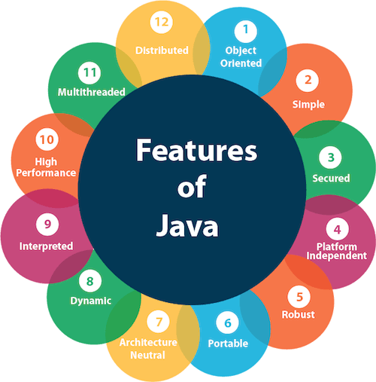

Slide 11
A list of most important features of Java language is given below.
Simple
Object-Oriented
Portable
Platform independent
Secured
Robust
Architecture neutral
Interpreted
High Performance
Multithreaded
Distributed
Dynamic

Slide 12
First Java Program | Hello World Example
class Simple{
public static void main(String args[]){
System.out.println("Hello Java");
}
}
To compile : javac Simple.java
To execute : java Simple
Output : Hello Java

Slide 13
Parameters used in First Java Program
Let's see what is the meaning of class, public, static, void, main, String[], System.out.println().
class keyword is used to declare a class in java.
public keyword is an access modifier which represents visibility. It means it is visible to all.
static is a keyword. If we declare any method as static, it is known as the static method. The core advantage of the static method is that there is no need to create an object to invoke the static method. The main method is executed by the JVM, so it doesn't require to create an object to invoke the main method. So it saves memory.
void is the return type of the method. It means it doesn't return any value.
main represents the starting point of the program.
String[] args is used for command line argument. We will learn it later.
System.out.println() is used to print statement. Here, System is a class, out is the object of PrintStream class, println() is the method of PrintStream class. We will learn about the internal working of System.out.println statement later.

Slide 14
JVM JRE JDK

Slide 15
Java is a high level programming language. A program written in high level language cannot be run on any machine directly. First, it needs to be translated into that particular machine language. The javac compiler does this thing, it takes java program (.java file containing source code) and translates it into machine code (referred as byte code or .class file).

Slide 16
Java Virtual Machine (JVM)
This is generally referred as JVM. Before, we discuss about JVM lets see the phases of program execution. Phases are as follows:
we write the program,
then we compile the program
and at last we run the program.
1) Writing of the program is of course done by java programmer like you and me.
2) Compilation of program is done by javac compiler, javac is the primary java compiler included in java development kit (JDK). It takes java program as input and generates java bytecode as output.
3) In third phase, JVM executes the bytecode generated by compiler. This is called program run phase.
So, now that we understood that the primary function of JVM is to execute the bytecode produced by compiler.
Each operating system has different JVM, however the output they produce after execution of bytecode is same across all operating systems. That is why we call java as platform independent language.

Slide 17
Java Virtual Machine (JVM) is a virtual machine that resides in the real machine (your computer) and the machine language for JVM is byte code. This makes it easier for compiler as it has to generate byte code for JVM rather than different machine code for each type of machine. JVM executes the byte code generated by compiler and produce output. JVM is the one that makes java platform independent.

Slide 18
JVM (Java Virtual Machine) is an abstract machine. It is called a virtual machine because it doesn't physically exist. It is a specification that provides a runtime environment in which Java bytecode can be executed. It can also run those programs which are written in other languages and compiled to Java bytecode.
JVMs are available for many hardware and software platforms. JVM, JRE, and JDK are platform dependent because the configuration of each OS is different from each other. However, Java is platform independent. There are three notions of the JVM: specification, implementation, and instance.
The JVM performs the following main tasks:
Loads code
Verifies code
Executes code
Provides runtime environment

Slide 19
So, now we understood that the primary function of JVM is to execute the byte code produced by compiler. Each operating system has different JVM, however the output they produce after execution of byte code is same across all operating systems. Which means that the byte code generated on Windows can be run on Mac OS and vice versa. That is why we call java as platform independent language.

Slide 20
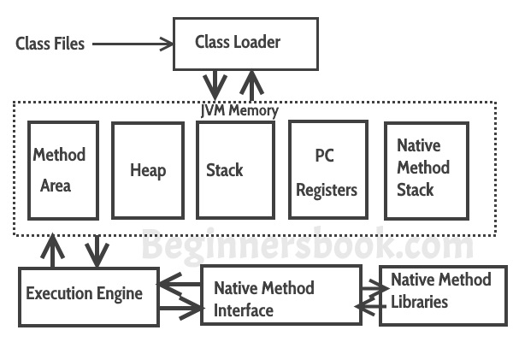

Slide 21
Java Runtime Environment(JRE)
JRE is an acronym for Java Runtime Environment. It is also written as Java RTE. The Java Runtime Environment is a set of software tools which are used for developing Java applications. It is used to provide the runtime environment. It is the implementation of JVM. It physically exists. It contains a set of libraries + other files that JVM uses at runtime.
The implementation of JVM is also actively released by other companies besides Sun Micro Systems.

Slide 22
Java Runtime Environment(JRE)
JRE is a part of JDK which means that JDK includes JRE. When you have JRE installed on your system, you can run a java program however you won’t be able to compile it. JRE includes JVM, browser plug-in and applets support. When you only need to run a java program on your computer, you would only need JRE.

Slide 23
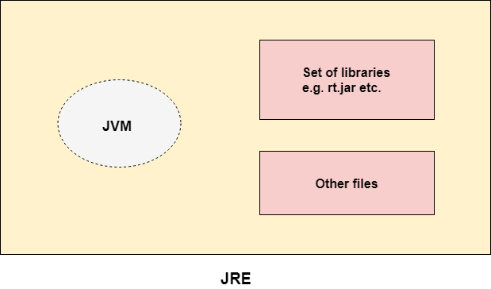

Slide 24
JAVA DEVELOPMENT KIT- JDK
JDK is an acronym for Java Development Kit. The Java Development Kit (JDK) is a software development environment which is used to develop Java applications and applets. It physically exists. It contains JRE + development tools.
JDK is an implementation of any one of the below given Java Platforms released by Oracle Corporation:
Standard Edition Java Platform
Enterprise Edition Java Platform
Micro Edition Java Platform
The JDK contains a private Java Virtual Machine (JVM) and a few other resources such as an interpreter/loader (java), a compiler (javac), an archiver (jar), a documentation generator (Javadoc), etc. to complete the development of a Java Application.

Slide 25
JAVA DEVELOPMENT KIT- JDK
The Java Development Kit (JDK) is a software development environment used for developing Java applications and applets. It includes the Java Runtime Environment (JRE), an interpreter/loader (Java), a compiler (javac), an archiver (jar), a documentation generator (Javadoc) and other tools needed in Java development.

Slide 26
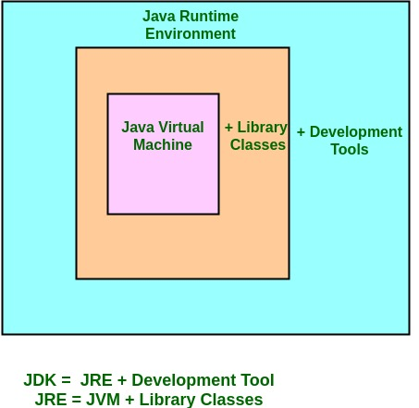

Slide 27
Java Variables Data Types Operators

Slide 28
Java Variables
A variable is a container which holds the value while the java program is executed. A variable is assigned with a data type.
Variable is a name of memory location. There are three types of variables in java: local, instance and static.
There are two types of data types in java: primitive and non-primitive.

Slide 29
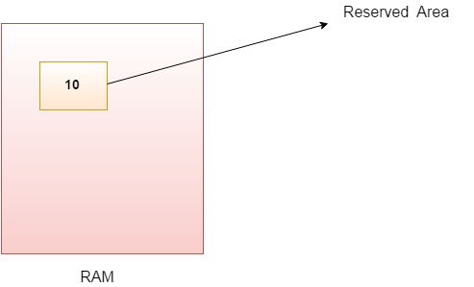
Variable
Variable is name of reserved area allocated in memory. In other words, it is a name of memory location. It is a combination of "vary + able" that means its value can be changed.

Slide 30
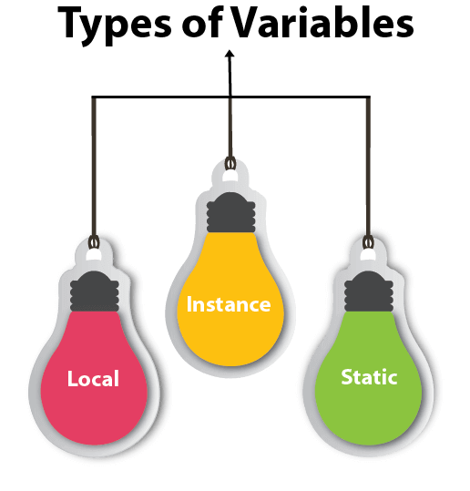
Types of Variables
There are three types of variables in java:
local variable
instance variable
static variable

Slide 31
1) Local Variable
A variable declared inside the body of the method is called local variable. You can use this variable only within that method and the other methods in the class aren't even aware that the variable exists.
A local variable cannot be defined with "static" keyword.
2) Instance Variable
A variable declared inside the class but outside the body of the method, is called instance variable. It is not declared as static.
It is called instance variable because its value is instance specific and is not shared among instances.
3) Static variable
A variable which is declared as static is called static variable. It cannot be local. You can create a single copy of static variable and share among all the instances of the class. Memory allocation for static variable happens only once when the class is loaded in the memory.

Slide 32
Data Types in Java
Java is a statically-typed programming language. It means, all variables must be declared before its use. That is why we need to declare variable's type and name.
Data types specify the different sizes and values that can be stored in the variable. There are two types of data types in Java:
Primitive data types: The primitive data types include Boolean , char, byte, short, int, long, float and double.
Non-primitive data types: The non-primitive data types include Classes, Interfaces, and Arrays.

Slide 33
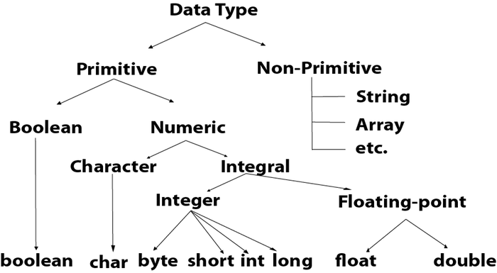

Slide 34
Java Primitive Data Types
In Java language, primitive data types are the building blocks of data manipulation. These are the most basic data types available in Java language.
There are 8 types of primitive data types:
Boolean data type
byte data type
char data type
short data type
int data type
long data type
float data type
double data type

Slide 35
Java defines eight primitive types of data: byte, short, int, long, char, float, double, and boolean. The primitive types are also commonly referred to as simple types, and both terms will be used in this lecture. These can be put in four groups:
• Integers This group includes byte, short, int, and long, which are for whole-valued signed numbers.
• Floating-point numbers This group includes float and double, which represent numbers with fractional precision.
• Characters This group includes char, which represents symbols in a character set, like letters and numbers.
• Boolean This group includes boolean, which is a special type for representing true/false values.

Slide 36
Data Type | Default Value | Default size
boolean | false | 1 bit
char | '\u0000' | 2 byte
byte | 0 | 1 byte
short | 0 | 2 byte
int | 0 | 4 byte
long | 0L | 8 byte
float | 0.0f | 4 byte
double | 0.0d | 8 byte

Slide 37
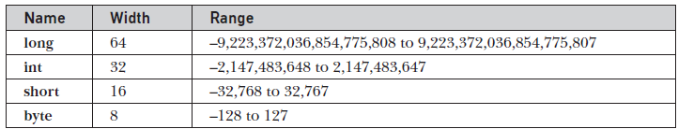

Integers
Floating-Point Types
Characters
Thus, in Java char is a 16-bit type. The range of a char is 0 to 65,536. There are no negative chars. The standard set of characters known as ASCII still ranges from 0 to 127 as always, and the extended 8-bit character set, ISO-Latin-1, ranges from 0 to 255.
Booleans
Java has a primitive type, called boolean, for logical values. It can have only one of two possible values, true or false.

Slide 38
Type Conversion and Casting
When one type of data is assigned to another type of variable, an automatic type conversion will take place if the following two conditions are met:
• The two types are compatible.
• The destination type is larger than the source type.
When these two conditions are met, a widening conversion takes place. For example, the int type is always large enough to hold all valid byte values, so no explicit cast statement is required.
For widening conversions, the numeric types, including integer and floating-point types, are compatible with each other. However, there are no automatic conversions from the numeric types to char or boolean. Also, char and boolean are not compatible with each other.
As mentioned earlier, Java also performs an automatic type conversion when storing a literal integer constant into variables of type byte, short, long, or char.

Slide 39
Automatic Type Promotion in Expressions
Java defines several type promotion rules that apply to expressions. They are as follows: First,
all byte, short, and char values are promoted to int, as just described. Then, if one operand
is a long, the whole expression is promoted to long. If one operand is a float, the entire
expression is promoted to float. If any of the operands are double, the result is double.

Slide 40
Operators in java
Operator in java is a symbol that is used to perform operations. For example: +, -, *, / etc.
There are many types of operators in java which are given below:
Unary Operator,
Arithmetic Operator,
Shift Operator,
Relational Operator,
Bitwise Operator,
Logical Operator,
Ternary Operator and
Assignment Operator.

Slide 41
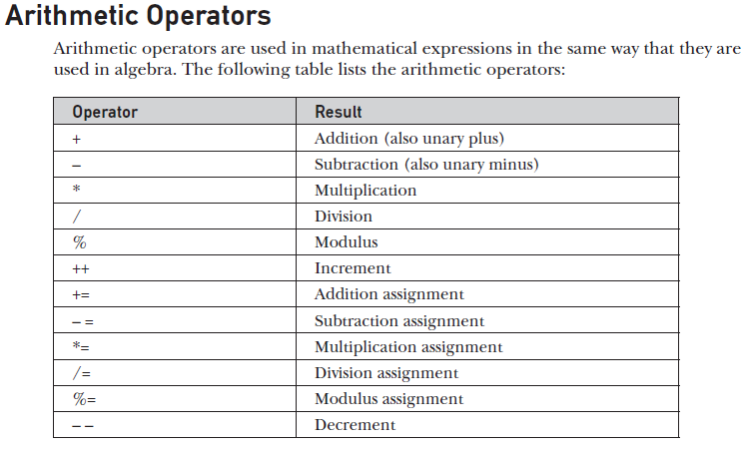

Slide 42
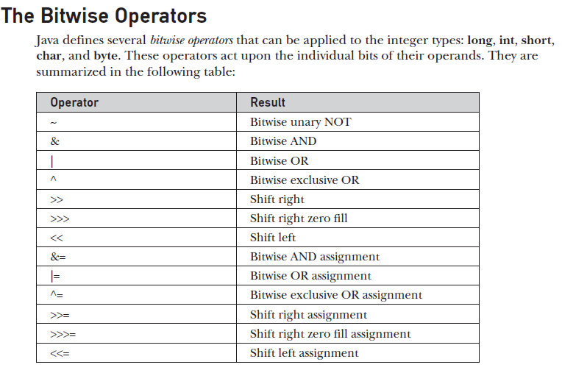

Slide 43
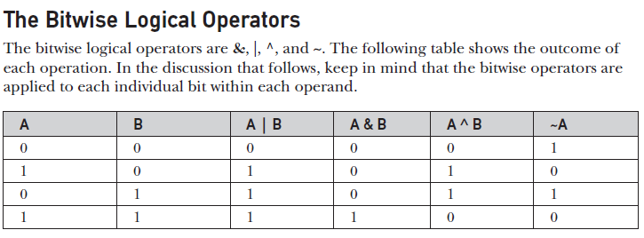
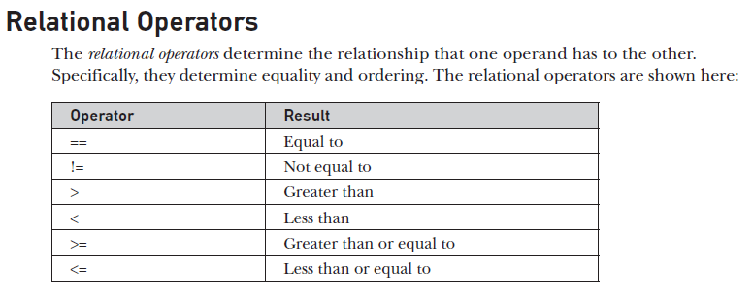

Slide 44
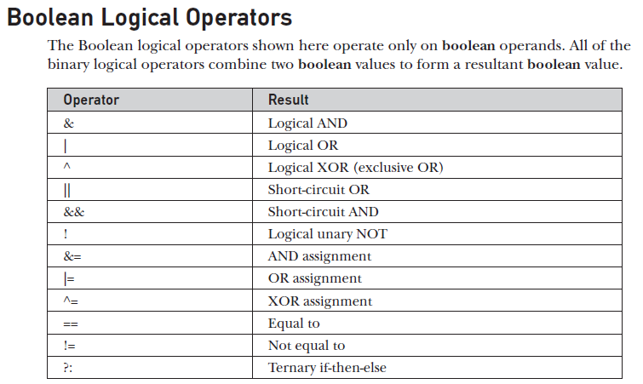

Slide 45
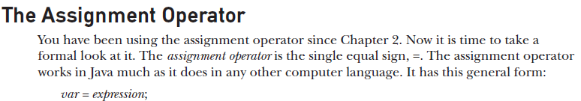
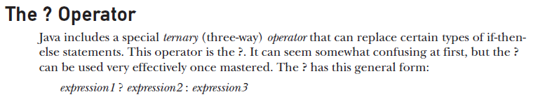

Slide 46
Operator Type | Category | Precedence
Unary | postfix | expr++ expr--
 | prefix | ++expr --expr +expr -expr ~ !
Arithmetic | multiplicative | * / %
 | additive | + -
Shift | shift | << >> >>>
Relational | comparison | < > <= >= instanceof
 | equality | == !=
Bitwise | bitwise AND | &
 | bitwise exclusive OR | ^
 | bitwise inclusive OR | |
Logical | logical AND | &&
 | logical OR | ||
Ternary | ternary | ? :
Assignment | assignment | = += -= *= /= %= &= ^= |= <<= >>= >>>=

Slide 47
Operator Precedence in Java
This determines which operator needs to be evaluated first if an expression has more than one operator. Operator with higher precedence at the top and lower precedence at the bottom.

Slide 48
Unary Operators ++ – – ! ~
Multiplicative * / %
Additive + –
Shift << >> >>>
Relational > >= < <=
Equality == !=
Bitwise AND &
Bitwise XOR ^
Bitwise OR |
Logical AND &&
Logical OR ||
Ternary ?:
Assignment = += -= *= /= %= > >= < <= &= ^= |=

Slide 49
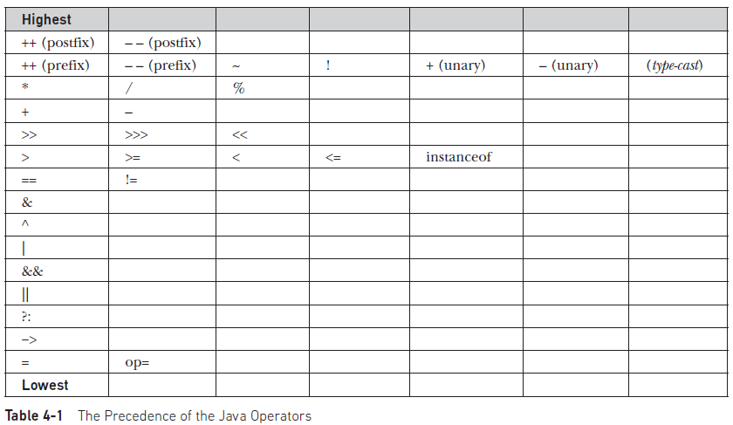

Slide 50
Introducing Programming with an Example
Listing 2.2 Computing the Area of a Circle
This program computes the area of the circle.

Slide 51
The algorithm for this
program can be described as follows:
1. Read in the radius.
2. Compute the area using the following formula:
area = radius * radius * p
3. Display the area.

Slide 52
You already know that every
Java program begins with a class declaration in which the keyword class is followed by the
class name. Assume that you have chosen ComputeArea as the class name. The outline of the program would look like this:
public class ComputeArea {
// Details to be given later
}

Slide 53
As you know, every Java program must have a main method where program execution
begins. So the program is expanded as follows:
public class ComputeArea {
public static void main(String[] args) {
// Step 1: Read in radius
// Step 2: Compute area
// Step 3: Display the area
}
}

Slide 54
The program needs to read the radius entered by the user from the keyboard. This raises two
important issues:
■ Reading the radius.
■ Storing the radius in the program.
A variable designates a location in memory for storing data and computational results in the program. A variable has a name that can be used to access the memory location.
Rather than using x and y as variable names, choose descriptive names: in this case, radius for radius, and area for area.

Slide 55
Declare radius and area as double-precision floating-point numbers. The program can be expanded as follows:
public class ComputeArea {
public static void main(String[] args) {
double radius;
double area;
// Step 1: Read in radius
// Step 2: Compute area
// Step 3: Display the area
}
}

Slide 56
Trace a Program Execution
allocate memory for radius
public class ComputeArea {
/** Main method */
public static void main(String[] args) {
double radius;
double area;
// Assign a radius
radius = 20;
// Compute area
area = radius * radius * 3.14159;
// Display results
System.out.println("The area for the circle of radius " +
radius + " is " + area);
}
}
radius
no value

Slide 57
Trace a Program Execution
public class ComputeArea {
/** Main method */
public static void main(String[] args) {
double radius;
double area;
// Assign a radius
radius = 20;
// Compute area
area = radius * radius * 3.14159;
// Display results
System.out.println("The area for the circle of radius " +
radius + " is " + area);
}
}
memory
radius
no value
area
no value
allocate memory for area

Slide 58
Trace a Program Execution
public class ComputeArea {
/** Main method */
public static void main(String[] args) {
double radius;
double area;
// Assign a radius
radius = 20;
// Compute area
area = radius * radius * 3.14159;
// Display results
System.out.println("The area for the circle of radius " +
radius + " is " + area);
}
}
assign 20 to radius
radius
20
area
no value

Slide 59
Trace a Program Execution
public class ComputeArea {
/** Main method */
public static void main(String[] args) {
double radius;
double area;
// Assign a radius
radius = 20;
// Compute area
area = radius * radius * 3.14159;
// Display results
System.out.println("The area for the circle of radius " +
radius + " is " + area);
}
}
memory
radius
20
area
1256.636
compute area and assign it to variable area

Slide 60

Trace a Program Execution
public class ComputeArea {
/** Main method */
public static void main(String[] args) {
double radius;
double area;
// Assign a radius
radius = 20;
// Compute area
area = radius * radius * 3.14159;
// Display results
System.out.println("The area for the circle of radius " +
radius + " is " + area);
}
}
memory
radius
20
area
1256.636
print a message to the console

Slide 61
The plus sign (+) has two meanings: one for addition and the other for concatenating strings. The plus sign (+) in lines 13–14 is called a string concatenation operator. It combines two strings if two operands are strings. If one of the operands is a nonstring (e.g., a number), the nonstring value is converted into a string and concatenated with the other string. So the plus signs (+) in lines 13–14 concatenate strings into a longer string, which is then displayed in the output. Strings and string concatenation will be discussed further “The String Type.”

Slide 62
A string constant cannot cross lines in the source code. Thus the following statement would
result in a compile error:
System.out.println("Introduction to Java Programming,
by ABCD");
To fix the error, break the string into separate substrings, and use the concatenation operator (+)
to combine them:
System.out.println("Introduction to Java Programming, " +
"by ABCD");

Slide 63
In last programme the radius is fixed in the source code. To use a different radius, you have to
modify the source code and recompile it. Obviously, this is not convenient. You can use the
Scanner class for console input.
Java uses System.out to refer to the standard output device and System.in to the standard input device. By default the output device is the display monitor, and the input device is the keyboard. To perform console output, you simply use the println method to display a
primitive value or a string to the console. Console input is not directly supported in Java, but you can use the Scanner class to create an object to read input from System.in, as follows:
Scanner input = new Scanner(System.in);

Slide 64
The syntax new Scanner(System.in) creates an object of the Scanner type. The syntax Scanner input declares that input is a variable whose type is Scanner. The whole line Scanner input = new Scanner(System.in) creates a Scanner object and assigns its reference
to the variable input. An object may invoke its methods. To invoke a method on an object is to ask the object to perform a task. You can invoke the methods in Table 2.1 to read various types of input.

Slide 65
Using Scanner for Input
First, you should add the following line to your program at the beginning of the source code file, before the "public class...":
import java.util.Scanner;
Then include the following statement at the beginning of your main() routine:
Scanner stdin = new Scanner( System.in );

Slide 66
This creates a variable named stdin of type Scanner. (You can use a different name for the variable if you want; "stdin" stands for "standard input.") You can then use stdin in your program to access a variety of subroutines for reading user input.
For example, the function stdin.nextInt() reads one value of type int from the user and returns it. It is almost the same as TextIO.getInt() except for two things: If the value entered by the user is not a legal int, then stdin.nextInt() will crash rather than prompt the user to re-enter the value. And the integer entered by the user must be followed by a blank space or by an end-of-line, whereas TextIO.getInt() will stop reading at any character that is not a digit.

Slide 67
There are corresponding methods for reading other types of data, including
stdin.nextDouble(),
stdin.nextLong(),
stdin.nextBoolean().
(stdin.nextBoolean() will only accept "true" or "false" as input.)
stdin.nextLine()
stdin.next(), returns a string of non-blank characters.

Slide 68
import java.util.Scanner;
class GetInputFromUser
{
public static void main(String args[])
{
int a;
float b;
String s;
Scanner in = new Scanner( System.in);
System.out.println("Enter a string");
s = in.nextLine();
System.out.println("You entered string "+s);
System.out.println("Enter an integer");
a = in.nextInt();
System.out.println("You entered integer "+a);
System.out.println("Enter a float");
b = in.nextFloat();
System.out.println("You entered float "+b);
}
}

Slide 69
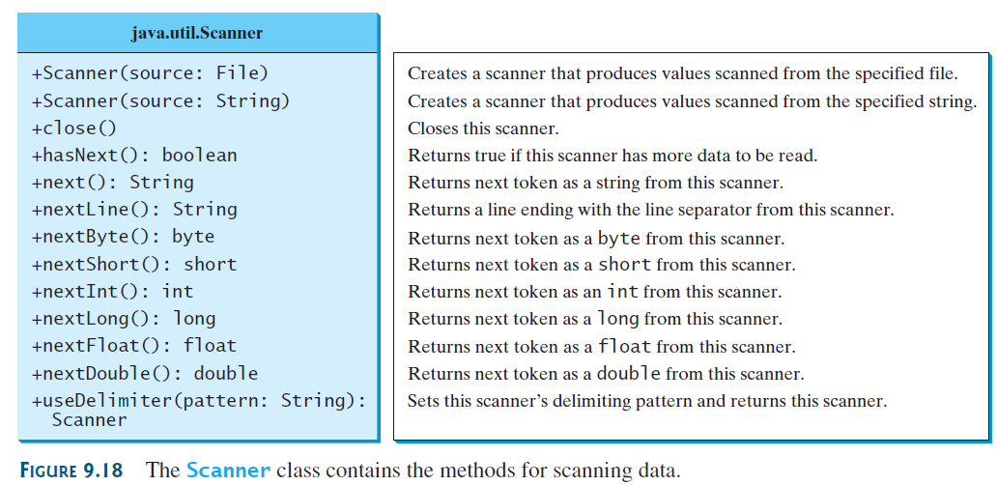

Slide 70
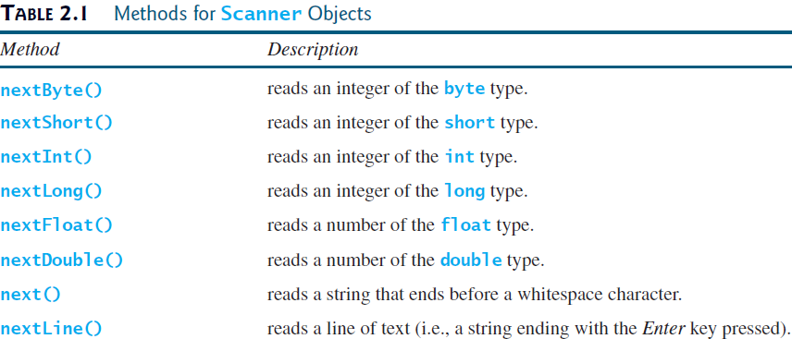

Slide 71
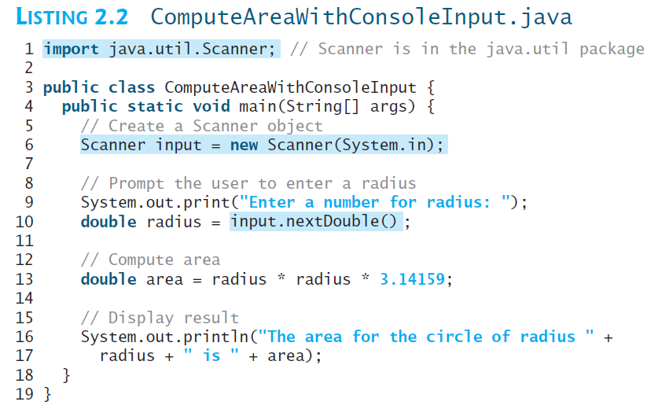

Slide 72
The Scanner class is in the java.util package. It is imported in line 1. Line 6 creates a Scanner object.
The statement in line 9 displays a message to prompt the user for input.
System.out.print ("Enter a number for radius: ");
The print method is identical to the println method except that println moves the cursor to the next line after displaying the string, but print does not advance the cursor to the next line when completed.
The statement in line 10 reads an input from the keyboard.
double radius = input.nextDouble();
After the user enters a number and presses the Enter key, the number is read and assigned to radius.

